Slide 1

Digital Pharmacy
Nico, Gabriel, Hsaine, Rinson
Notes:
Sacha

Slide 2
Digital Pharmacy addresses the pain points of small and medium sized pharmacies by digitalizing and automating their workflow.
Notes:
Sacha

Slide 3



Pharmacy pain points
Digital Pharmacy solution
Difficult to keep up with pharmacies operating as large chains and therefore have more possibilities and resources
Expand customer base by implementing an online purchasing solution
No or not complete view on orders and patients history can lead to abuse or incorrect usage of medication
Creating a single source of truth by storing necessary data in a relational database
High manual workload leads to cutbacks in providing personal consultation to patients
Reducing the manual workload by automating the process of selling medication
Notes:
Sacha

Slide 4
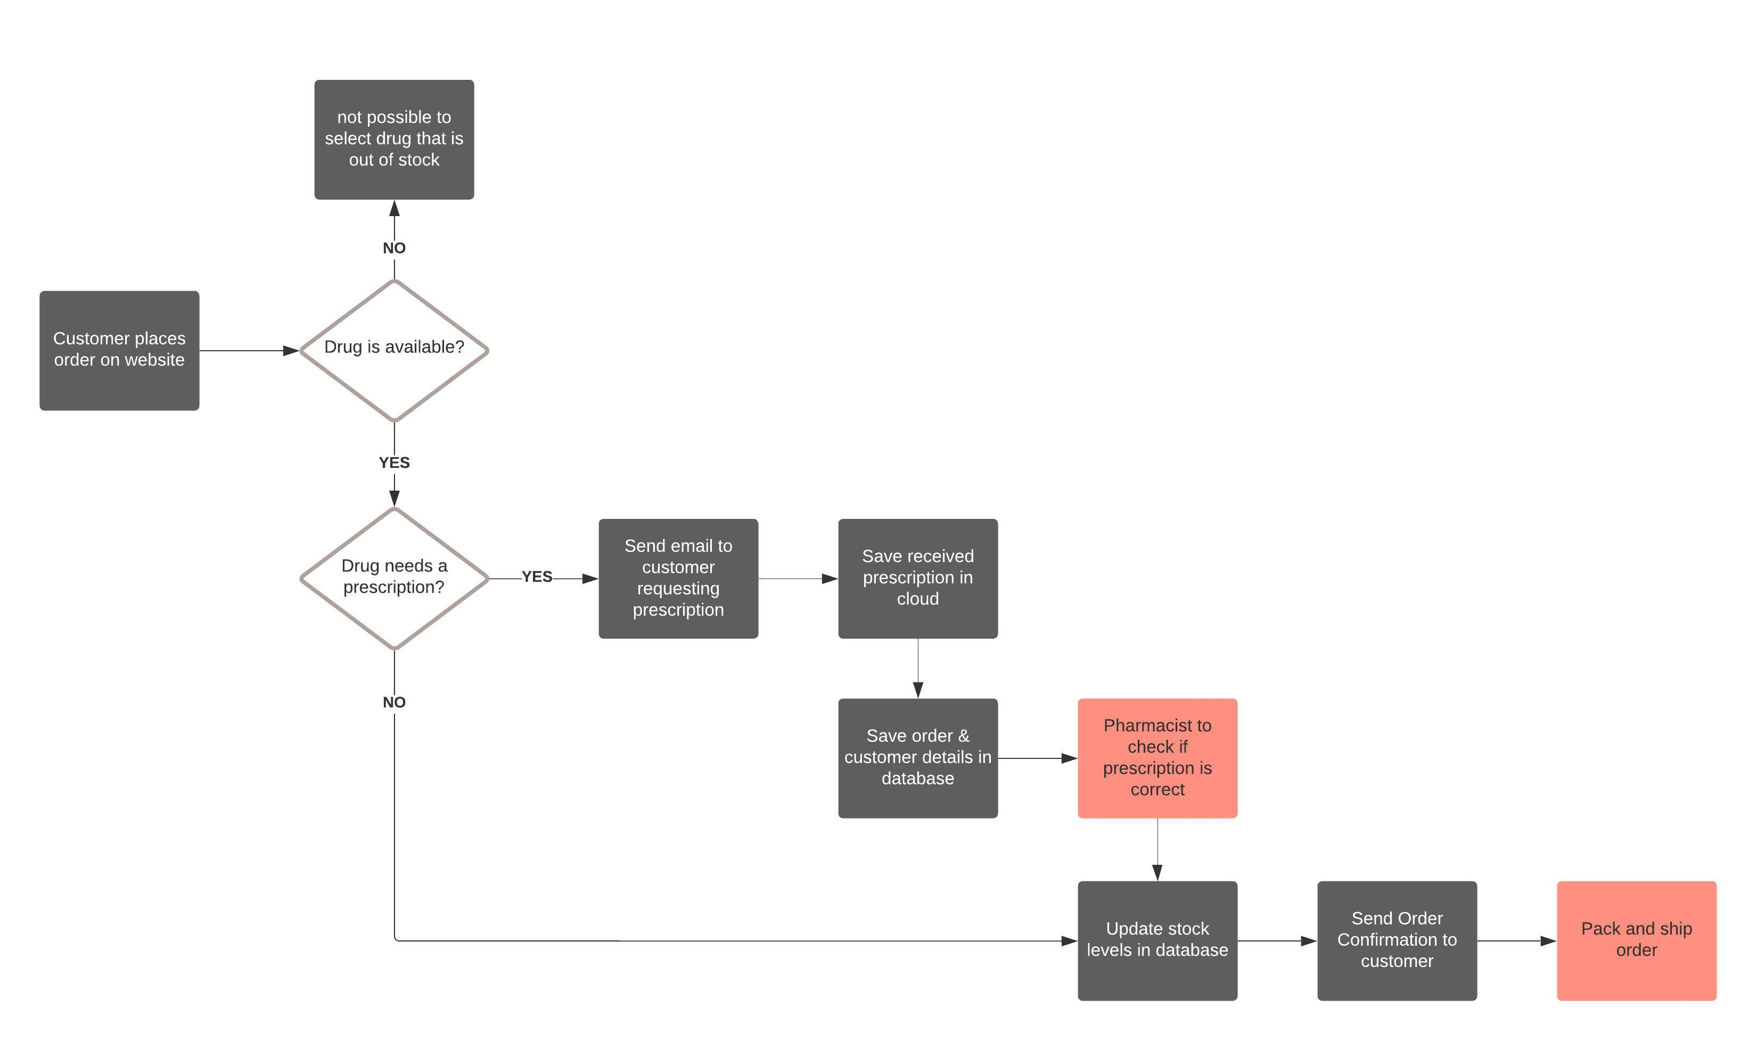
Pharmacy Journey
Automatic task
Manual task
Notes:
Rinson

Slide 5
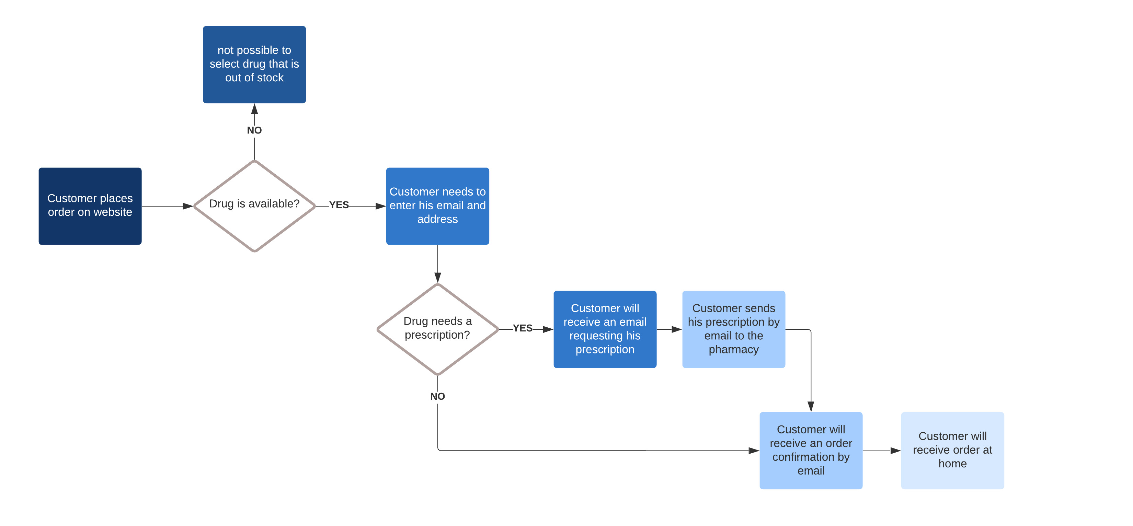
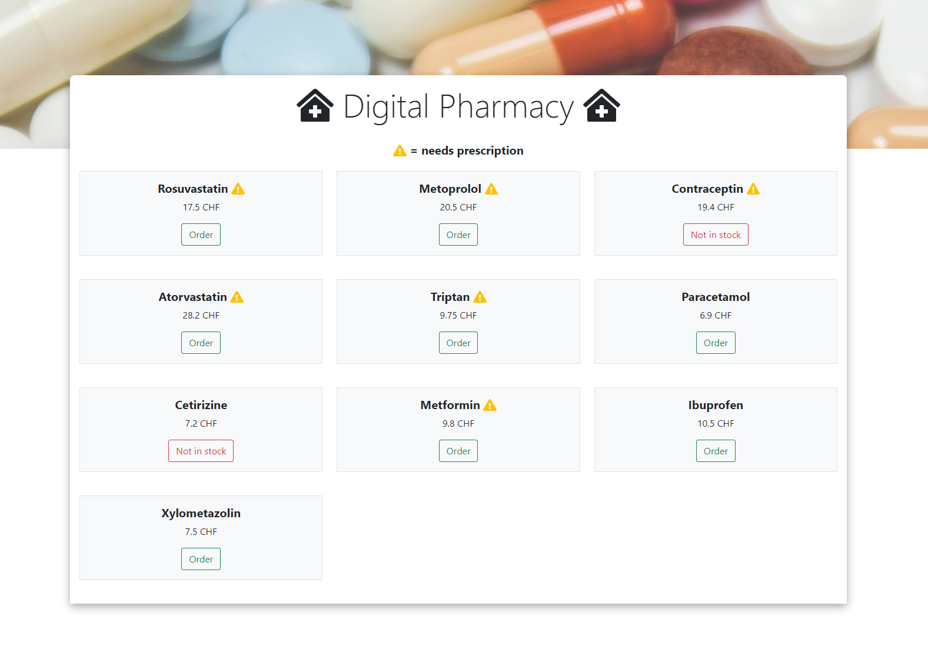

Customer Journey
Notes:
Gabriel

Slide 6
Insert video here

Slide 7
Highlights
Optical Character Recognition (OCR)
AirTable database
Digital Pharmacy uses Google Cloud Vision to automatically process received prescriptions and extract all necessary information from the file, regardless if it’s a digital pdf or a scan. Google Cloud Vision is a cutting edge AI application that is able to recognize characters in documents and images and extract them.
Digital Pharmacy uses AirTable to store the overview of drugs, if they need a prescription or not and their stock level as well as patient data for prescription orders. AirTable allows to build relational database with the option to chose between a no-code and traditional SQL language implementation. Like this, Digital Pharmacy can ensure that the database can be managed by a small pharmacy without an IT specialist, but can also be used as a fully functional SQL database if needed.
Notes:
Nico

